Slide 1

Automotive Technology: A Systems Approach, 8e
Chapter 35: Hybrid Vehicles
Rob Thompson and Jack Erjavec, Automotive Technology: A Systems Approach, 8th Edition. © 2025 Cengage. All Rights Reserved. May not be scanned, copied or duplicated, or posted to a publicly accessible website, in whole or in part.

Slide 2
Chapter Objectives
35.01 Explain the differences between the different platforms for hybrid vehicles.
35.02 Describe the components used in hybrid propulsion systems.
35.03 Explain hybrid vehicle HVAC operation.
35.04 Describe the types of hybrids available from various manufacturers.
35.05 Describe hybrid four-wheel drive systems.
35.06 Describe what preventative maintenance procedures are unique to a hybrid vehicle.

Slide 3
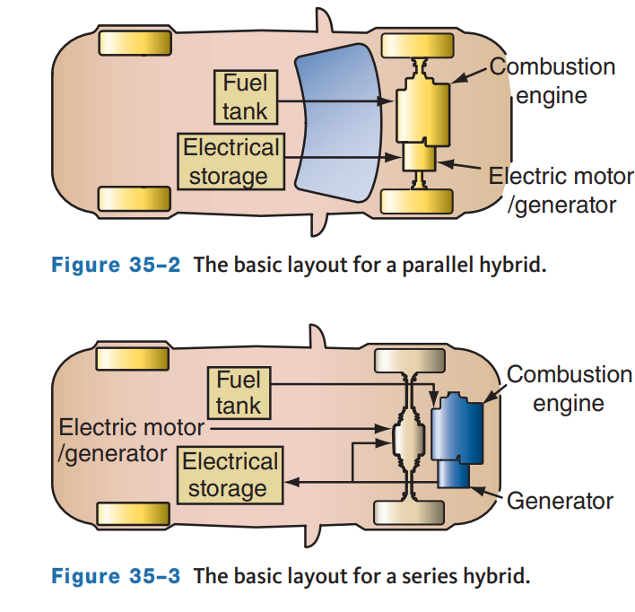
Types of Hybrid Vehicles
35.01 Explain the differences between the different platforms for hybrid vehicles.
Often, hybrids are categorized as parallel, series, or series-parallel designs.
Few modern hybrid vehicles are parallel types, which rely on power from an electric motor and the engine.
When necessary, the motor and engine work together (in parallel) to drive the vehicle.
In a series hybrid, the engine never directly powers the vehicle.
An electric motor powers the vehicle.
The gasoline or diesel engine drives a generator, and the generator either charges the batteries or directly powers the electric motor that drives the wheels.

Slide 4
Other Hybrid Classifications
Hybrid configurations are further defined by the role of the electric motor.
Although there are many variations in designs, hybrids can be classified as mild or full.
Also, keep in mind, non-hybrid vehicles may be equipped with some of the features of a hybrid vehicle, such as stop-start and regenerative braking.
These are designed to minimize fuel consumption.
A mild hybrid has stop-start, regenerative braking, and electric motor assist available when the engine needs added power to overcome the load.
An electric motor helps or assists the engine to overcome increased load, but the vehicle is never powered by only the electric motor.
Mild hybrids include those vehicles that have a stop-start system, in which the engine turns off when it would otherwise be idle and then restarts instantly on demand.
A full hybrid can run on just the engine, just the batteries, or a combination of the two.
A full hybrid has stop-start, regenerative braking, electric motor assist, and can be driven by only electricity.

Slide 5
Plug-In Hybrids
Plug-in hybrid electric vehicles (PHEVs) are full hybrids with larger batteries.
A battery charger can be plugged into a normal 120-volt outlet Level 1 or 240-volt Level 2 charging station to recharge the battery.
Charged overnight, PHEVs can drive up to 60 miles without the engine turning on.
When the batteries run low, the engine starts and powers the vehicle and the generator operates to charge the batteries.
The biggest advantage of plug-in hybrids is they can be driven in an electric-only mode for a distance.
During that time, the vehicle consumes no fuel.
Under normal conditions, a plug-in hybrid can be twice as fuel-efficient as a regular hybrid.
A fully charged PHEV will produce half the exhaust emissions of a normal HEV.
The manufacturing costs of a PHEV are about 20 percent higher than a regular HEV mainly due to the price of the larger batteries.

Slide 6
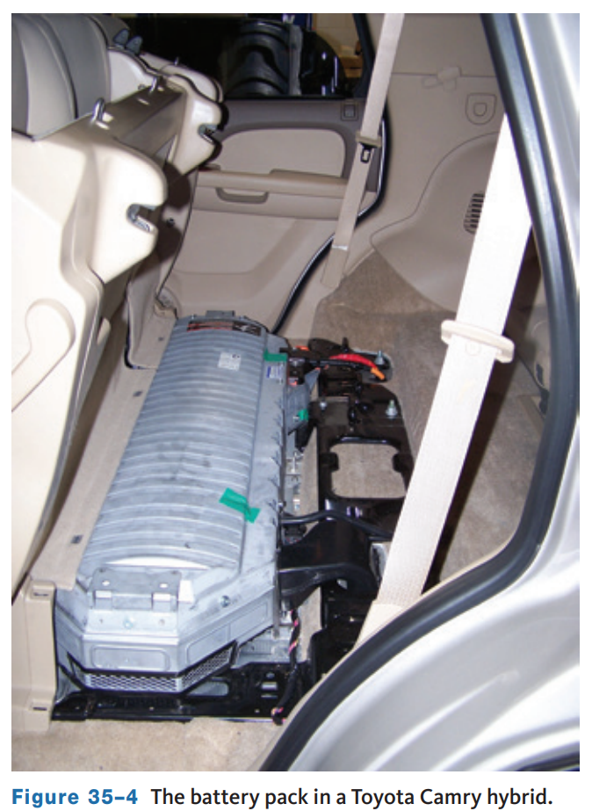
Batteries
35.02 Describe the components used in hybrid propulsion systems.
The available voltage of a hybrid’s battery pack depends on the system and the manufacturer.
The voltage range is from 48 volts to 360 volts.
Most battery packs are basically several small batteries connected together to provide the required voltage.
Hybrids also have an auxiliary 12-volt battery to power conventional electrical items, such as lighting, wipers, sound systems, etc.

Slide 7
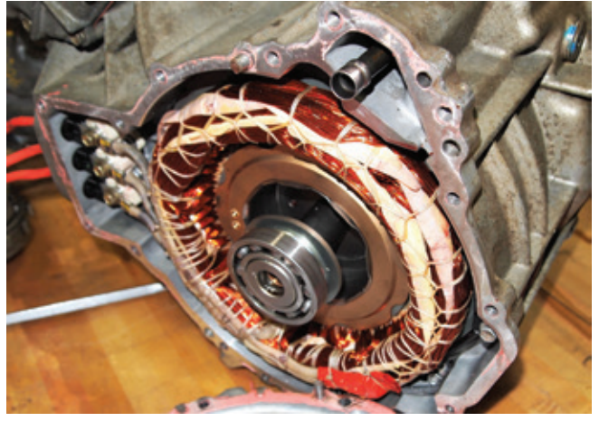
Motor/Generators
The main difference between a generator and a motor is that a motor has two magnetic fields that oppose each other, whereas a generator has one magnetic field and wires are moved through the field.
Using electronics to control the current to and from the battery, a motor that also works as a generator is used in hybrids; these are commonly referred to as motor/generators or MGs.
Motor/generators may be mounted externally to the engine and connected to the crankshaft with a drive belt.
Many hybrids place the motor/generators in the transmission or transaxle assembly.

Slide 8
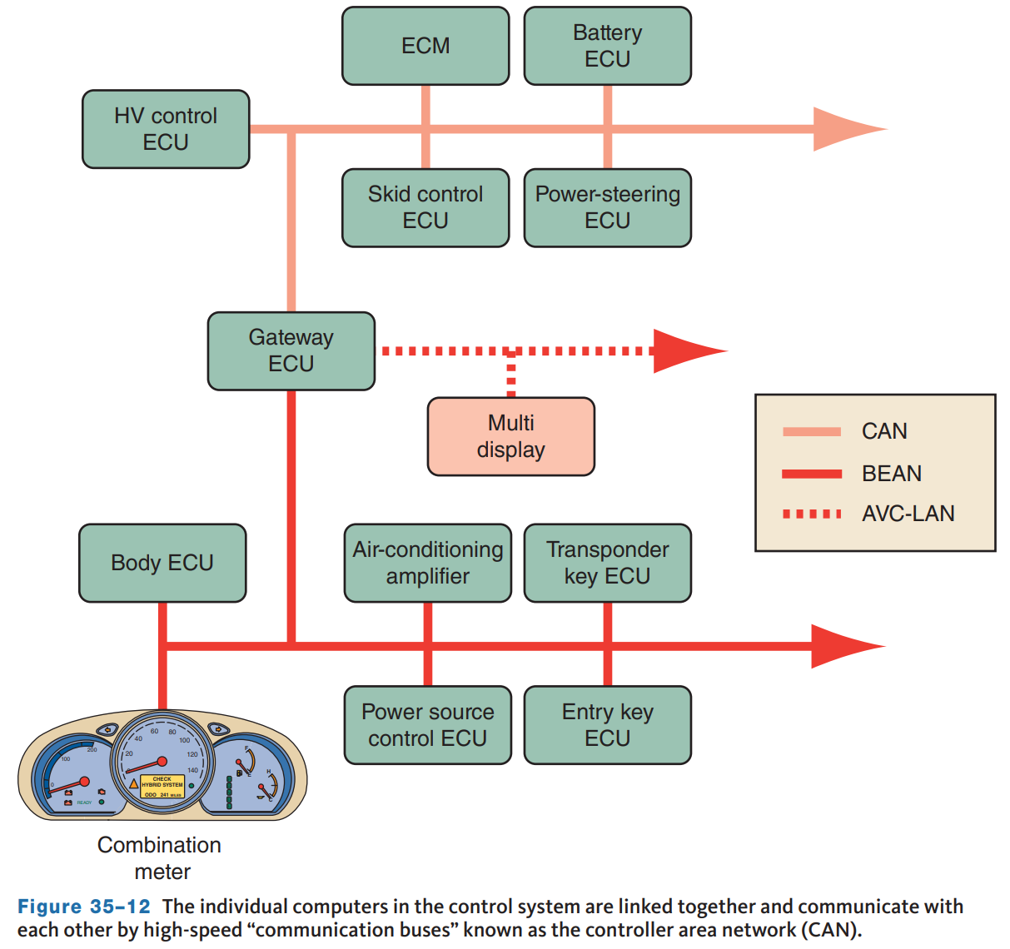
Control System
The switching between the electric motor and gasoline engine is controlled by computers, as are other features of the vehicle.
The control systems are extremely complex.
They have very fast processing speeds and real-time operating systems.
The individual computers are linked together and communicate with each other through CAN communications.
The various computers include the electric motor controller, engine controller, battery management system, charge controller, brake system controller, transmission controller, and electrical grid controller.

Slide 9
Internal Combustion Engine
The engine used in most hybrids is a four-stroke cycle engine that burns gasoline. These engines are very similar to those used in conventional vehicles.
The engine relies on advanced technologies to reduce emissions and increase overall efficiency.
The engines are typically Atkinson cycle engines in other countries where diesel fuel is commonly used, and diesel hybrids are being tested.
Diesel engines have the highest thermal efficiency of any internal combustion engine. Because of this efficiency, diesel hybrids can achieve outstanding fuel economy.
Mazda announced it will soon release a new plug-in series hybrid SUV with a rotary engine.
The rotary will not drive the wheels, instead it will power the generator to produce electricity for the electric motors.

Slide 10
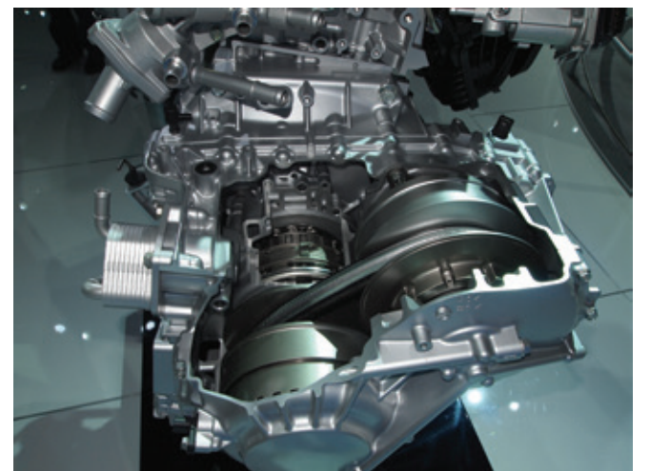
Transmissions
The transmission used in an HEV can be a normal transmission or one especially designed for the vehicle.
Often, a continuously variable transmission (CVT) is used, whose gear ratios change according to load.
In either case, the gear ratios are designed to allow the engine to run at its most efficient speed according to its current operating condition.

Slide 11
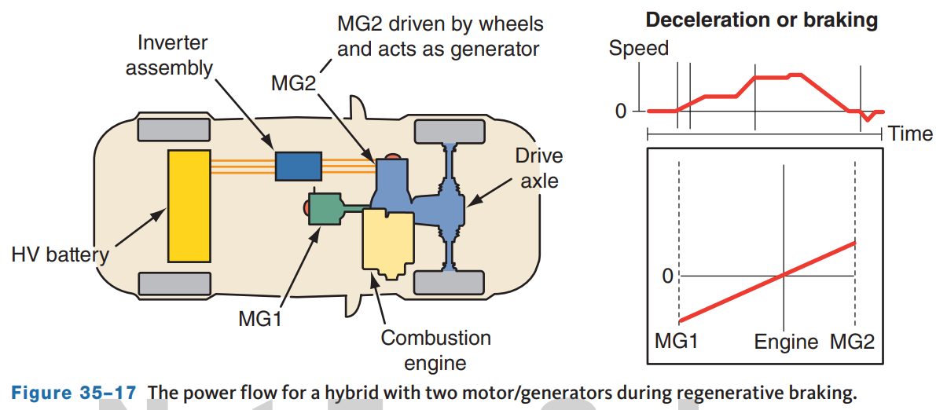
Regenerative Brakes
Regenerative braking is the process that allows a vehicle to recapture and store part of the kinetic energy that would ordinarily be lost during braking.
A vehicle has more kinetic energy when it is moving fast; therefore, regenerative braking is more efficient at higher speeds.
When the brakes are applied in a conventional vehicle, friction at the wheel brakes converts the vehicle’s kinetic energy into heat.
With regenerative braking, that energy is used to recharge the batteries.

Slide 12
Basic Systems (1 of 2)
Many different layouts and systems are used in today’s hybrid vehicles. Hybrids can be further defined by the location and purpose of the electric motor(s) in the system.
Belt Alternator Starter
  The least complex is the Belt Alternator Starter (BAS) system. The BAS replaces the traditional starter and generator in a conventional vehicle. The motor/generator is located where the generator would normally be and is connected to the engine’s crankshaft by a drive belt. When the engine is running, the drive belt spins the motor’s rotor and the motor acts as a generator to charge the batteries.
Integrated Starter Alternator Damper (ISAD)
  The integrated starter alternator damper (ISAD) system replaces the conventional starter, generator, and flywheel with an electronically controlled compact electric motor. Also called integrated motor assist (IMA), or integrated starter generator (ISG)

Slide 13
Basic Systems (2 of 2)
Power-Split System
  Currently, many full hybrid vehicles use a power-split system. They are the foundation for series-parallel hybrids and are capable of instantaneously switching from one power source to another or combining the two.
Motors in Transmission
  This system relies on electric motors built into the transmission housing and connected to the transmission’s planetary gearsets. Most of these systems are based on simple planetary gearsets coupled to two electronically controlled AC motors.
Electric 4WD
  Some 4WD hybrids use an electric motor, differential, and rear transaxle housing to drive the rear wheels. This unit is not mechanically tied to the front drive axles; rather, it’s action is controlled by electronics.

Slide 14
Knowledge Check (1 of 2)
Which hybrid design type utilizes a power-split system?

Slide 15
Knowledge Check Answer (1 of 2)
  Answer: Series-Parallel

Slide 16
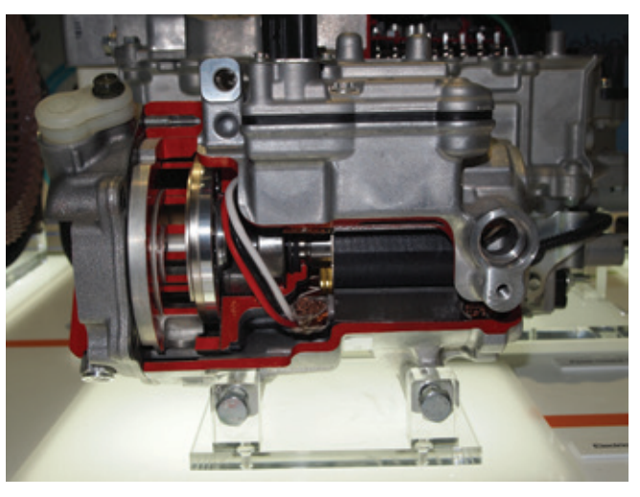
HVAC
35.03 Explain hybrid vehicle HVAC operation.
The engine can be used to supply the heat so heating and defrosting systems are similar to conventional vehicles.
Some hybrids however have additional electrical heaters.
These keep the passenger compartment warm when the engine is off.
HEV air-conditioning systems are identical to those used in a conventional vehicle, except a high-voltage motor is used to rotate the compressor.
This increases efficiency of the engine and gives conditioned air when the engine is off.

Slide 17
Power Brakes
Many power brake systems use engine vacuum and atmospheric pressure to multiply the effort applied to the brake pedal during braking.
Because there is an engine in an HEV, there is a natural vacuum source.
However, there is no vacuum when the engine is not running.
Therefore, some HEVs have an electrically powered vacuum pump fitted to the vacuum assist power brake system.
Most hybrids have an electro-hydraulic brake system.
An electric pump provides the hydraulic pressure for a hydraulic brake booster.
When the driver presses the brake pedal, the stroke sensor relays pedal movement to the skid control module.
The skid control module receives information from the hybrid control module regarding battery state-of-charge.
The amount of braking and regeneration required determines the force needed for the wheel brakes.

Slide 18
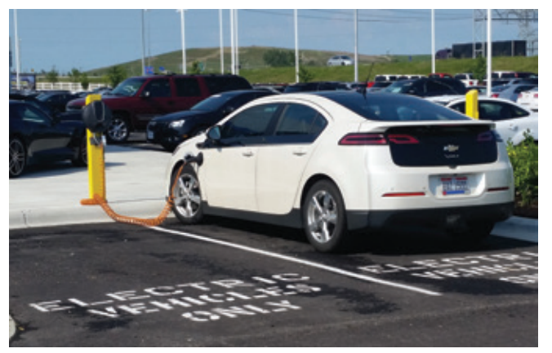
GM’s Series Hybrids
35.04 Describe the types of hybrids available from various manufacturers.
The Chevrolet Volt is a hatchback called an extended range EV, sold from 2011 to 2019.
According to the SAE, this model should be classified as series or plug-in hybrid.
Mostly, the Volt acts as an EV or series hybrid.
By combining the features of a battery-operated electric vehicle and a series hybrid, you have an extended range EV.
A smaller, shorter-range version is available as the Malibu Hybrid.

Slide 19
Basic Operation
The drivetrain allows the Volt to operate as a pure electric vehicle.
The distance it can travel on electricity alone is affected by many things including the battery’s state of charge (SOC), road conditions, driving style, driver comfort settings (e.g., HVAC), and weather.
Once the battery is mostly depleted, the engine starts and powers the generator and the car operates as a series hybrid.
While operating in the series mode at higher speeds and loads (normally above 30 miles per hour and/or under acceleration), the generator functions as a motor to aid the traction motor (MG-B).
Also under particular conditions, the engine is mechanically linked to the output of the gearset and assists both electric motors to drive the wheels; therefore, the Volt can operate as a series-parallel hybrid when additional power is required.
The first-generation Volt has four basic power modes: all battery-electric (charge depleting), low and high speed.

Slide 20
GM’s Parallel Hybrids
GM used a BAS hybrid system in 2006 through 2008 on some Saturn models, 2009 through 2010 on the Chevrolet Malibu, and in other Chevrolet and Buick models.
The motor/generator can serve as the starter, assist motor, and generator.
When working as a generator, it provides more than twice the output of a typical generator and is capable of providing 3,000 watts of continuous power.
During operation, the generator’s control module can get hot and excessive heat can destroy it.
So there is a coolant pump to keep engine coolant circulating through the module when the engine is off during stop-start.
That pump shares an electrical circuit with a second electric pump that keeps coolant circulating through the heater core when the engine is off and the vehicle is in the stop-start mode.
A third pump is used to keep transmission fluid circulating in the transmission when the engine is off during stop-start.

Slide 21
Honda’s Hybrid Systems
Until 2013, Honda hybrids used an ISAD system, called the integrated motor assist (IMA) system. Honda introduced their Insight in December 1999 and became the first manufacturer to offer hybrid vehicles in North America.
With this introduction came a new technology, placing an electric motor between the engine and transmission.
Since then, Honda has released many variations of this design and has offered many different hybrid models.
With this design, Honda was able to use a small efficient engine in a vehicle.
The power deficiencies of the engine are overcome by a small, efficient electric motor.
Through the years, this platform was improved to allow the vehicle to be powered by the engine, electric motor, or both.
Early Honda hybrids were assist-only hybrids.
As of 2023, Honda has the Accord Hybrid and CR-V hybrid.
The Insight and Clarity Plug-In Hybrid were available through 2022.

Slide 22
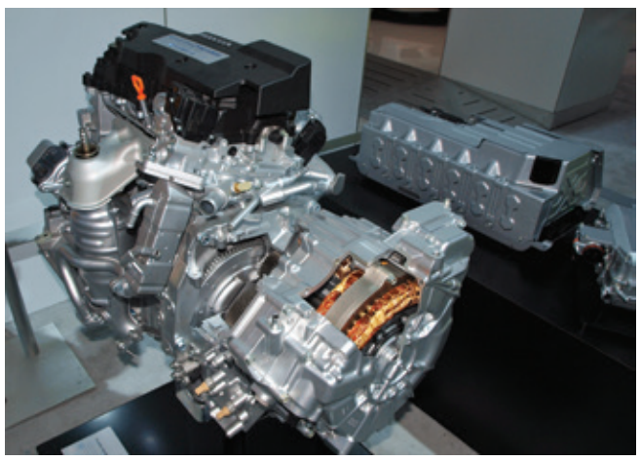
Two-Motor Hybrids
In 2013, the IMA system was replaced by a two-motor hybrid drive system, called the Two-Motor Hybrid Intelligent Multi-Mode Drive system.
The hybrid has a 2.0-liter four-cylinder engine, plus two electric motors, one of which is used for propulsion and is capable of delivering 204 peak combined horsepower, and 247 pounds-feet of torque.
The second motor is used as a generator and also serves as the engine’s starter.
In addition to the generator, the battery is recharged through regenerative braking.

Slide 23
Transmission
Most of Honda’s hybrids are equipped with either a manual transmission (early Insights) or a continuously variable transmission (e-CVT).
The manual transmissions are designed to be light, reduce power loss through friction, and make shifting easy.
The CVT (Honda Multimatic) uses computer-controlled drive and driven pulleys and a metal “push” belt running between the variable-width pulleys.
The CVT constantly adjusts to provide the most efficient drive ratio possible depending on torque load.

Slide 24
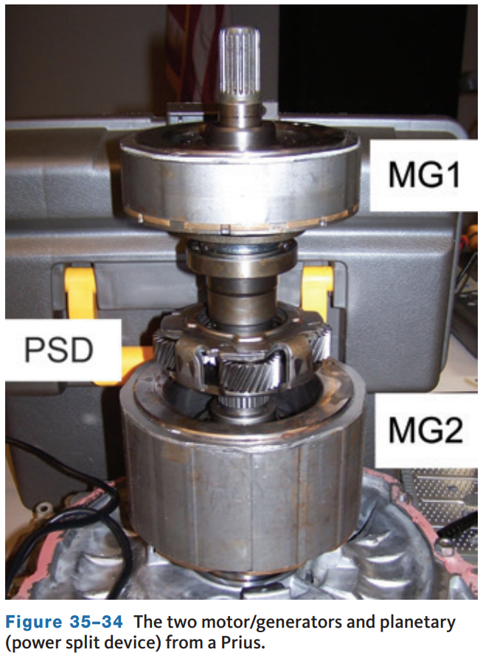
Toyota’s Hybrids
Toyota’s approach to hybridization is a combination of series and parallel hybrid platforms.
The system relies on two electric motor/generators, a power-split transaxle, and a high-voltage battery.
The power-split device (PSD), consisting of a planetary gearset, mechanically blends the output from the motors and an Atkinson cycle engine.
This system was called the Toyota Hybrid System (THS) when it was released, and the newer designs of the THS are called the Hybrid Synergy Drive (HSD) system.

Slide 25
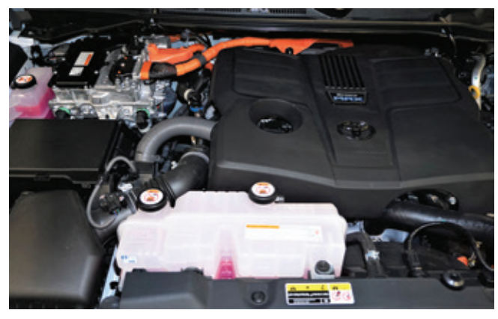
Other Hybrids from Toyota
Several hybrid cars are available from Toyota and Lexus.
Lexus has hybrids across six products, from the Prius-based CT Hybrid to the performance-oriented LC Hybrid sports car.
All of these except the LC Hybrid are based on the same architecture as the Prius.
The base engine, traction motor, and battery have been made more powerful to offset.
New in 2022, Toyota released the Tundra HEV.
A twin-turbo V6 is attached to a single 48 hp motor/generator and 10-speed automatic transmission.

Slide 26
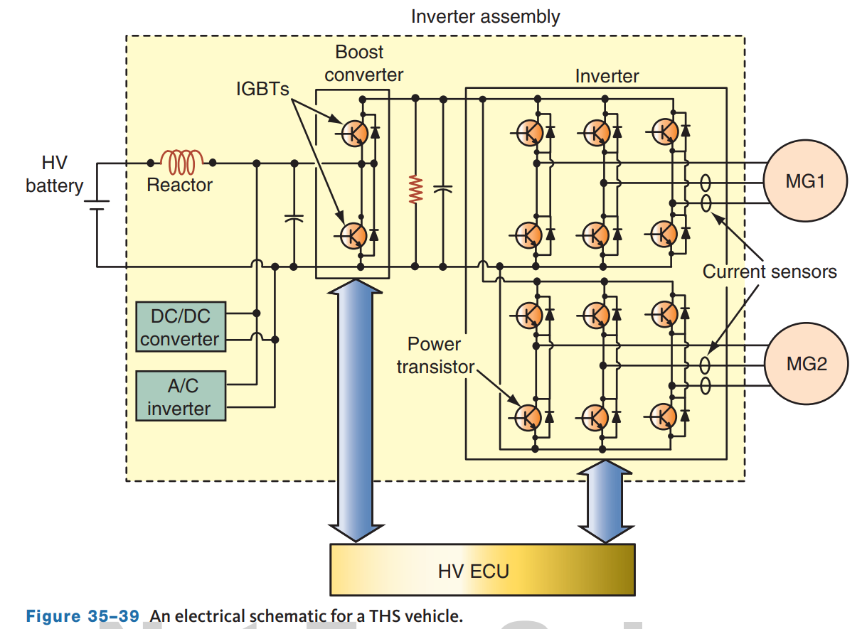
Electronic Controls
The control of the system is the responsibility of the Hybrid Vehicle Control Unit (HV ECU).
This module receives information from sensors and other processors and in turn sends commands to a variety of actuators and controllers.
The ECU coordinates the engine’s activity with the hybrid system.
It starts and stops the engine as needed, as well as controls the operation of the engine.
The HV ECU also makes sure there is proper phasing of AC to the motors.
This circuit is connected between the motor/generator and the battery pack.

Slide 27
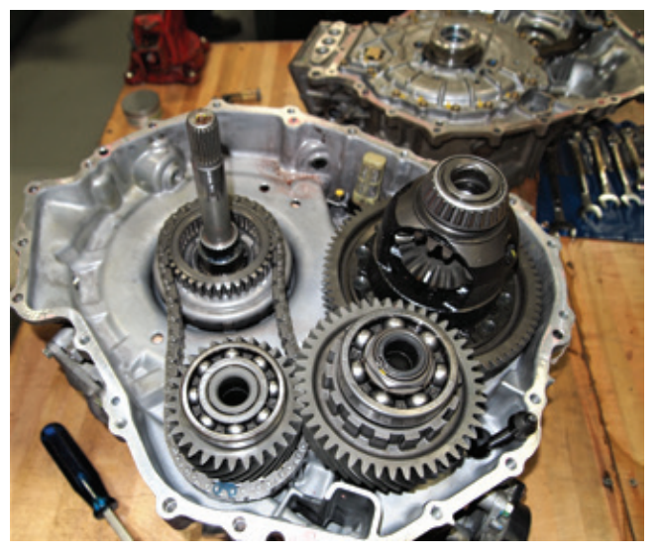
Power-Split Unit
The power-split device is also called the hybrid transaxle assembly.
It functions as a continuously variable transaxle, although it does not use the belts and pulleys normally associated with CVTs.
The variability of this transaxle depends on the action of MG1 and the torque supplied by MG2 and/or the engine.
Conventional final drive and differential units are used to allow for good handling and ample torque to drive the wheels.
The transaxle does not have a torque converter or clutch.

Slide 28
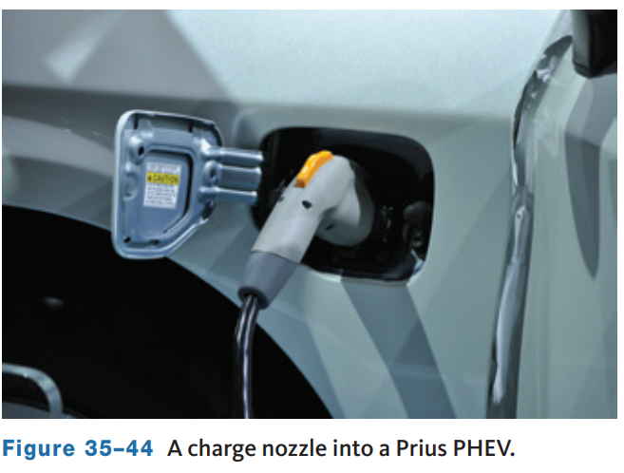
Prius Plug-In
In 2012, Toyota released a plug-in version of the Prius which allows for charging from a wall outlet.
The Prius Prime PHEV is based on the base Prius but is fitted with a 8.8 kWh Li-Ion battery pack.
  This allows it to operate as a pure EV for longer distances and higher speeds.
The estimated all-electric range is 25 miles, which results in an expected total range of 640 miles.
The car is also capable of driving up to 62 mph while in the electric mode.
The estimated fuel economy while operating as a gasoline-electric hybrid is 133 MPGe.

Slide 29
Knowledge Check (2 of 2)
What is the added benefit of a plug-in feature hybrid?
The battery is larger which allows it to operate as a pure EV for longer distances and higher speeds.

Slide 30
Knowledge Check Answer (2 of 2)
Answer:
This allows for charging from a wall outlet.

Slide 31
Ford Hybrids
In 2004, Ford released the Escape Hybrid.
This was the first hybrid SUV and the first hybrid vehicle built in North America.
The standard Escape Hybrid was front-wheel drive, and an Intelligent 4WD system was optional.
This option made the Escape the first 4WD hybrid.
In 2006, Ford released a hybrid version of the Escape’s cousin, the Mercury Mariner.
These SUVs were full hybrids and featured a CVT transmission and stop-start technology, as well as the ability to be powered solely by battery power.
In 2010, Ford released a hybrid edition of its mid-sized car, the Fusion.
Ford has offered two hybrid versions of the Fusion.
The difference between the two models is that the Fusion Energi is a PHEV.
Ford also released two hybrid versions of the compact car, the C-Max.
Mechanically, Fusion and C-Max hybrids are identical.

Slide 32
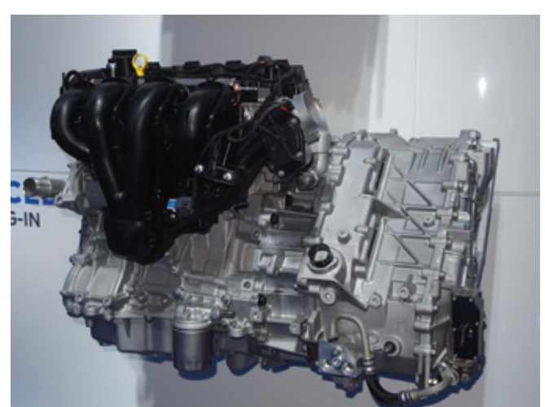
Operation
The basic components and operation of Ford’s earlier hybrid system are very similar to Toyota hybrids.
Newer hybrid model transmissions, such as used in the C-Max PHEV, still use two motors and a planetary gearset, but a transfer shaft is also used.
Power from either the engine, electric drive motor, or both, can be used to drive the wheels.
These are series-parallel hybrid vehicles.
Ford divides the operation of the hybrid system into three different modes: positive split, negative split, and electric modes.

Slide 33
4WD
Unlike the Toyotas with 4WD, the Escape and Mariner hybrids did not have a separate motor to drive the rear wheels.
Rather, these wheels were driven in a conventional way with a transfer case, rear driveshaft, and a rear axle assembly.
Current Escape plug-in hybrid models are not available with 4WD.
The Maverick offers AWD and the Explorer and F-150 hybrids do offer 4WD.

Slide 34
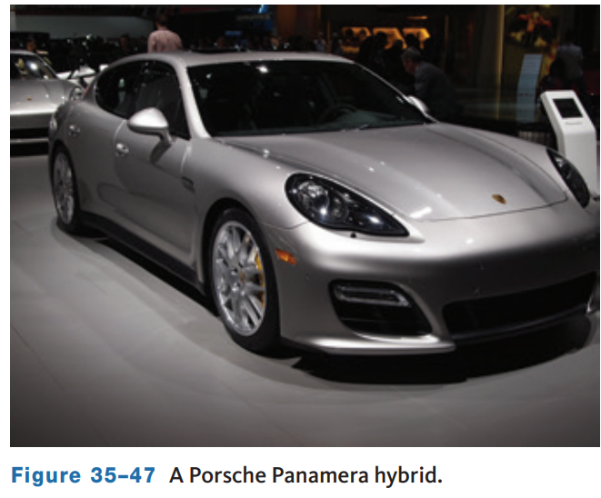
Porsche Hybrids
The same basic hybrid system is used in the Porsche Cayenne, Porsche Panamera, and Volkswagen Touareg.
Porsche continues to sell the Cayenne and Panamera E-Hybrid models but VW discontinued their hybrids in 2015.
In 2014, Porsche introduced their plug-in hybrid Panamera, with a new engine and electric powertrain.
The main difference between the various models is defined by the vehicle’s intended purpose and the body style.
Powertrain options include 2.9- and 3.0-liter turbocharged V6 engines and, on older models, a 4.0-liter turbocharged V8.

Slide 35
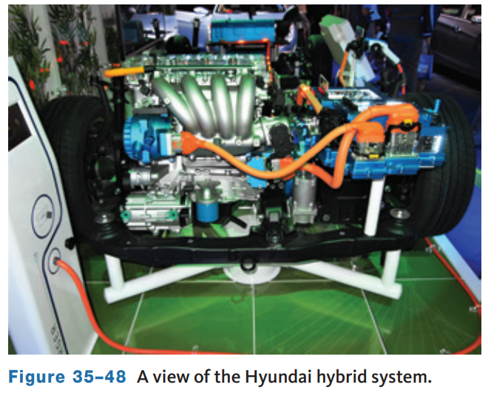
Hyundai and Kia Hybrids
Hyundai and Kia offer both hybrid and plug-in hybrid models in sedans and SUVs.
Both companies also have electric vehicles.
The Hyundai Tucson PHEV can go up to 33 miles propelled only by its electric motor. It has an EPA estimated fuel economy of 80 mpg-e and combined rating of 35 mpg.
The combined power of the 1.6-liter engine and electric motor for this parallel hybrid is 195 hp. Other models use a 2.0-liter engine with 192 combined hp.
The electric motor is sandwiched between the engine and a six-speed automatic transmission.

Slide 36
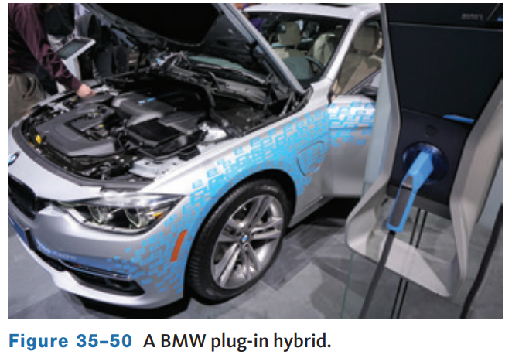
BMW Hybrids
Different BMW models are currently available as plug-in hybrids.
The technology used in the older models varies.
BMW’s 3 and 5 Series PHEVs are full hybrids.
A 54 hp (40 kW) electric motor is sandwiched between the engine and an eight-speed transmission.
The electric motor replaces the conventional starter and a belt-driven generator.
When the motor is a generator, it recharges the battery mounted below the floor in the trunk.

Slide 37
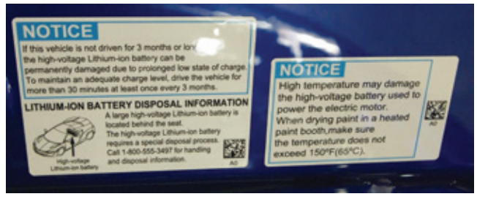
Maintenance and Service
35.06 Describe what preventative maintenance procedures are unique to a hybrid vehicle.
Hybrid vehicles are maintained and serviced in much the same way as conventional vehicles, except for the hybrid components.
The latter includes the high-voltage battery pack and circuits, which must be respected when doing any service.
Manufacturers list the recommended service intervals in their service information and owner’s manuals.
Care needs to be taken to avoid anything orange while carrying out the maintenance procedures.

Slide 38
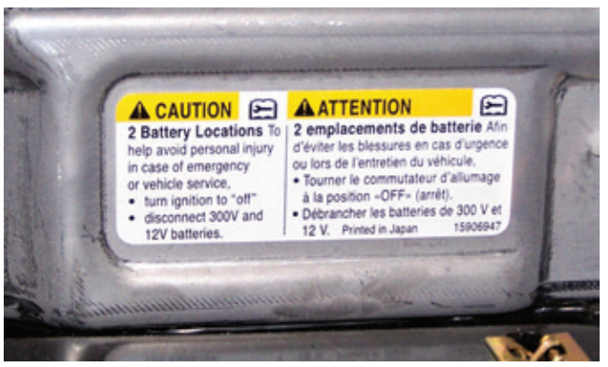
Safety Issues
Hybrid systems rely on very high voltages.
Always follow the correct procedures for disarming the high-voltage system before performing any service on or near the high-voltage circuits.
Air-conditioning, engine, transmission, and body work can require services completed around and/or with high-voltage systems.
If there is any doubt as to whether something has high voltage or not, or if the circuit is sufficiently isolated, test it before touching anything. High-voltage circuits are identifiable by size and color.
The cables have thicker insulation and are colored orange.

Slide 39
Maintenance
The engines used in hybrids are modified versions of engines found in other models offered by the manufacturer.
Other than fluid checks and changes, there is little maintenance required on these engines.
However, there is less freedom in deciding the types of fluids that can be used and the parts that can replace the original equipment.
Hybrids are not very forgiving.
Always use the exact replacement parts and the fluids specified by the manufacturer.

Slide 40
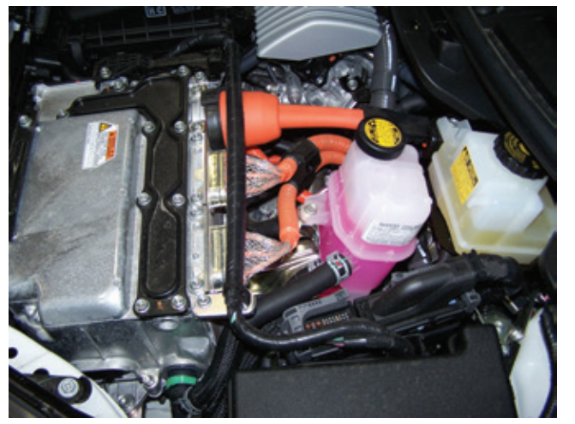
Cooling Systems
Special coolants are required in most hybrids because the coolant not only cools the engine but may also cool the inverter assembly.
Many hybrids have a complete and separate cooling system for the HV battery and electronics.
Cooling the inverter is important, and checking its coolant condition and level is an additional check during preventative maintenance.
Coolant, whether for the ICE or hybrid system, will eventually suffer from a depletion of the additives that protect the various components.

Slide 41
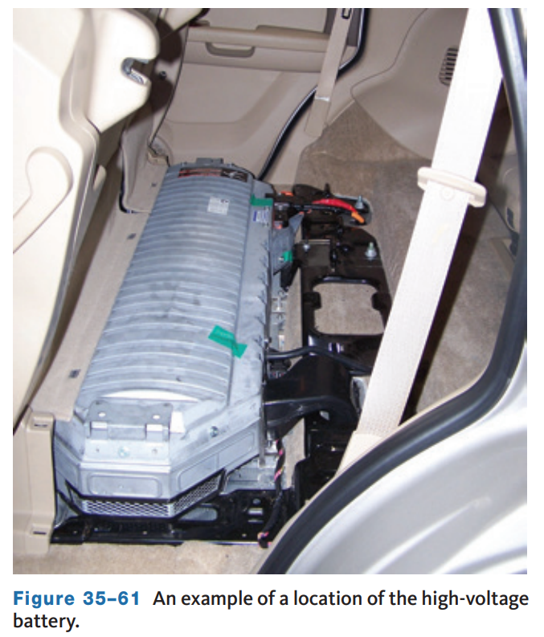
Batteries
Hybrids have two separate battery packs. One is the high-voltage pack and the other is a 12-volt battery.
The high-voltage battery pack supplies the power to start the engine, assist the engine during times of heavy load, and in full hybrid it supplies the energy to move the vehicle without the engine’s power.
The battery pack is the one that is most associated with the hybrid system.
The 12-volt battery is associated with the rest of the vehicle, such as the lights, accessories, and power equipment.

Slide 42
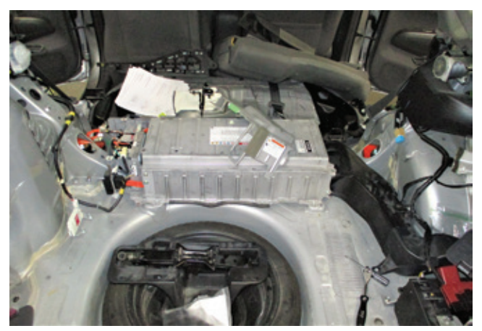
Battery Replacement and Repair
Begin by performing the high-voltage disconnect procedure per the manufacturers’ service information.
This typically includes disconnecting the 12-volt auxiliary battery and removing the high-voltage service plug. Before removing the service plug, perform a leak check of the high-voltage gloves.
Battery removal from most hybrid vehicles requires some disassembly of the interior.
Before removing items such as seats and interior trim, prepare an area of your workspace to place interior parts so they do not get damaged or dirty.

Slide 43
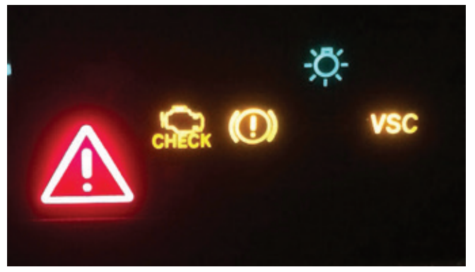
Diagnostics
All warning lamps in the instrument panel should be checked.
If any of these remains on after the engine is started, the cause should be identified and corrected before continuing with diagnosis.
Lastly, a scan tool should be used to retrieve any fault codes held in the computer’s memory.
In many cases, a manufacturer-specific scan tool is required to test hybrids.
Follow the prescribed sequence for retrieving and responding to all DTCs.
The scan tool also allows for some active tests that enable you to excite or disable certain outputs.

Slide 44
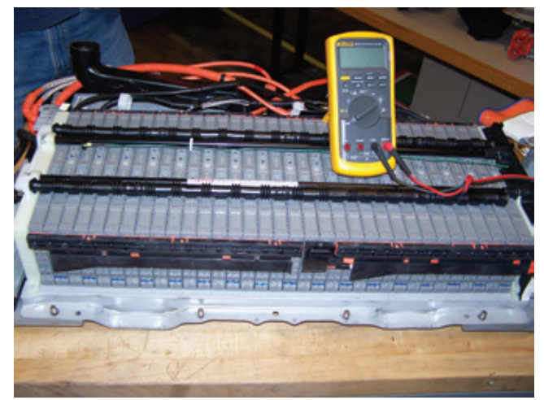
Test Equipment
To test high-voltage systems, you need a DMM and a good pair of insulating gloves.
Although the high-voltage system can be isolated from the rest of the vehicle, high voltage is still at and around the battery pack and inverter.
The DMM used to diagnose a hybrid vehicle is not the same meter you would use on a conventional vehicle.
The meter used on hybrids, electric vehicles, and fuel-cell vehicles must be classified as a category 3 or 4 (CAT III or CAT IV) meter.

Slide 45
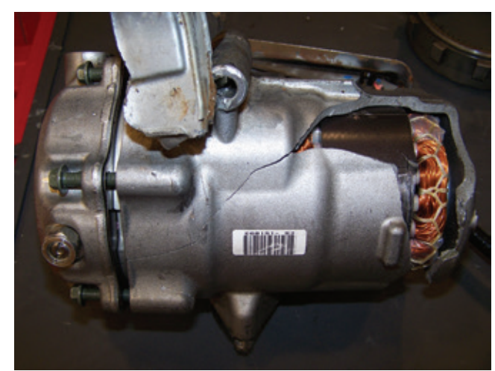
Air Conditioning
Most hybrids are equipped with an electrically powered A/C compressor.
The electrical units are powered by high voltage, and all precautions should be taken to work safely with these units.
The refrigerant oil used in all electrically operated compressors must meet the specifications given by the manufacturer.
In nearly all cases, the oil is synthetic and non-conductive and able to insulate the various electrical parts of the compressor.
The most common is Polyvinyl ether (PVE) oil.
The use of the regular refrigerant oil (PAG) can cause the destruction of the compressor.

Slide 46
Discussion
Hybrid vehicles require a specific mindset and some safety precautions.
Have a class discussion about hybrid service in general. What should you watch out for. How would you proceed with service? Make a list of your PPE.

Slide 47
Chapter Reflection
Please take a moment to compare your perception of the hybrid vehicles before and after you studied this chapter. Then respond to the following questions in one or two paragraphs. Use 150–200 words in your reflection.
Did anything in this chapter change your thinking about hybrid vehicles? Describe the aspects that interest you most.
Considering all you have learned, do you feel prepared to perform service on hybrid vehicles in the lab or shop? How can you be sure you are prepared?

